Slide 1

Version control concepts &
GIT Basics

Slide 2
2

Slide 3


Introduction to version control
Enables multiple people to simultaneously work on a single project.
Enables one person to use multiple computers to work on a project.
Integrates work done simultaneously by different team members.
Gives access to historical versions of project so that if one makes a mistake, s/he can roll back to a previous version.

Slide 4


Why Do We Need A Version Control System (VCS)?
Backup and Restore
Synchronization
Undo
Track Changes
Track Ownership
Sandboxing
Branching and merging

Slide 5


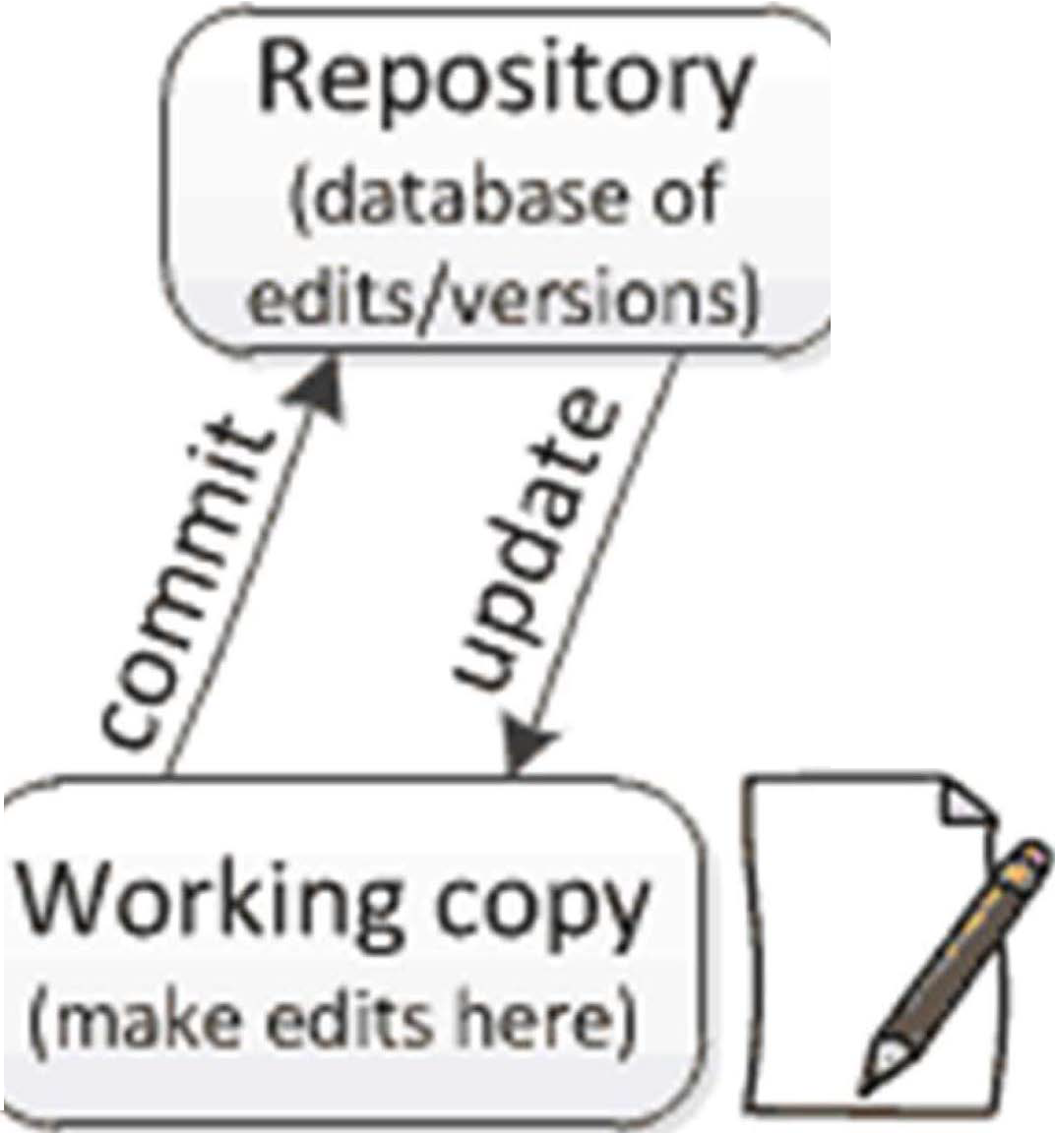
Repositories and working copies
Version control uses a repository and a working copy where we do our work.
Working copy is personal copy of all the files.
We changes this copy, without affecting our teammates.
When we are happy with edits, commit changes to repo.
A repo/repository is a database of all the
edits and historical versions {snapshots) of project.

Slide 6
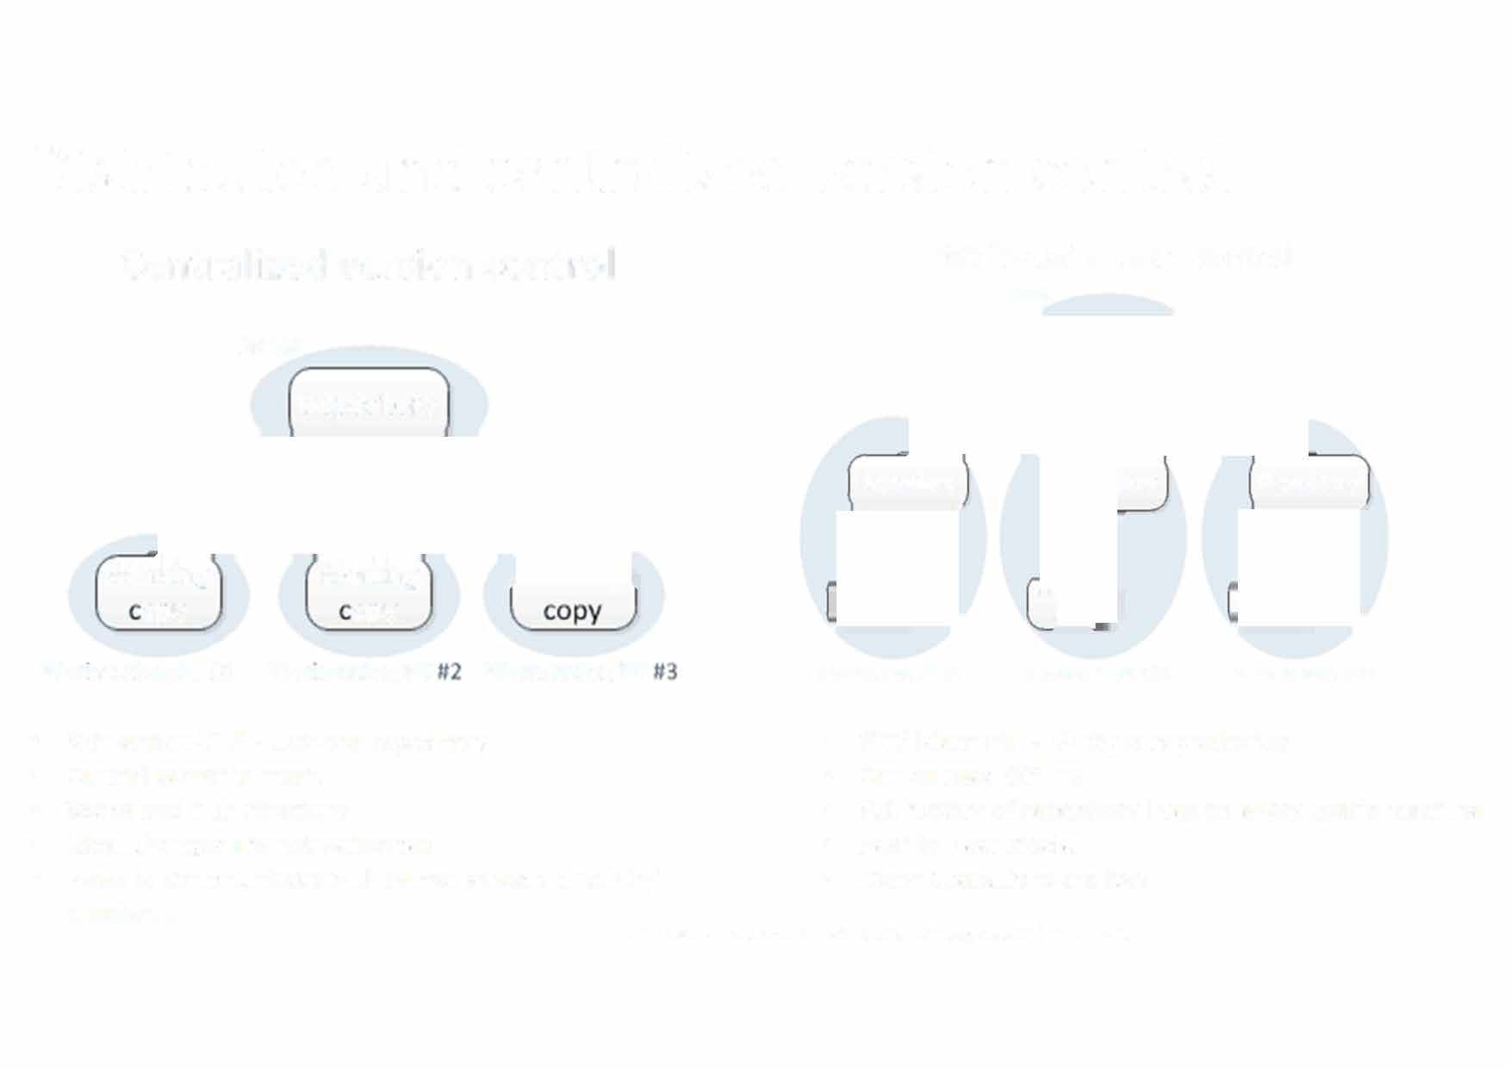
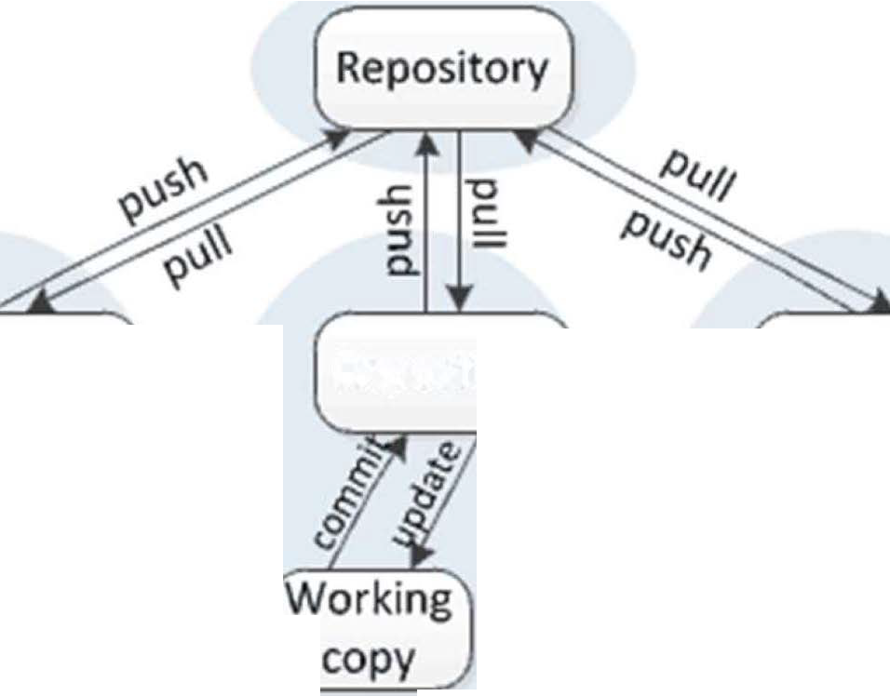
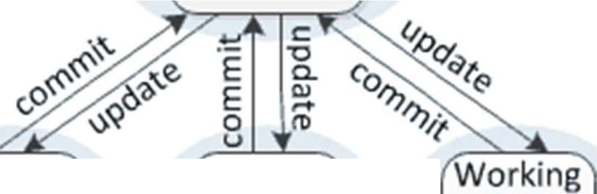
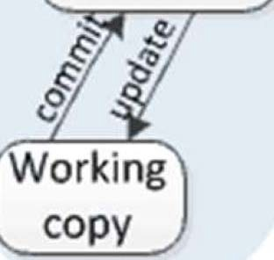
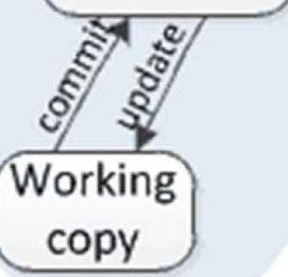
Distributed and centralized version control
Centralized version control
Server
Repository
Distributed version control
Server
Repository
Repository
Repository
Working
opy
Wor1<station/PC #1
Working op_{y}
Wor1<station/PC
Workstation/PC
Workstation/PC #1 Workstation/PC #2 Work.station/PC #3
•
•
•
•
•
Subversion/CVS - Just one repository Central server is must.
Spoke and hub structure
Local changes are not versioned
Need to communicate with server at each check in/ checkout.
•
•
•
•
•
GIT/ Mercurial - Multiple repositories Can be used Offline
Full history of repository lives on every user's machine
Peer to Peer model
Many operations are local

Slide 7

About Git
Created by Linus Torvalds - creator of Linux, in 2005
Goals of Git:
Speed
Support for non-linear development
(thousands of parallel branches)
Fully distributed
Able to handle large projects efficiently
• Git website: http:ljgit-scm.com/

Slide 8
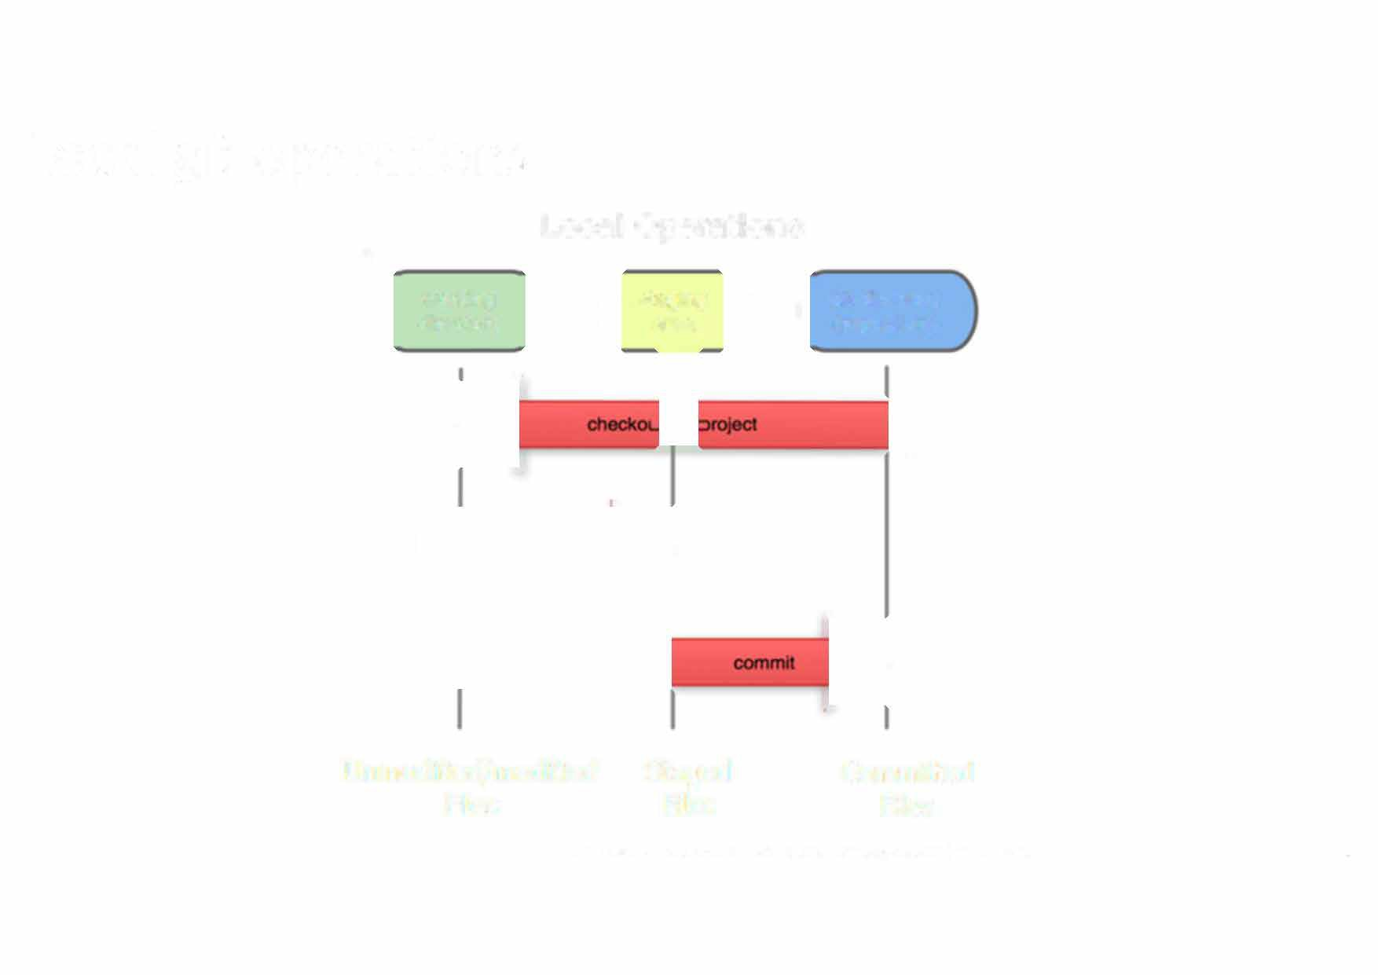





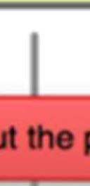


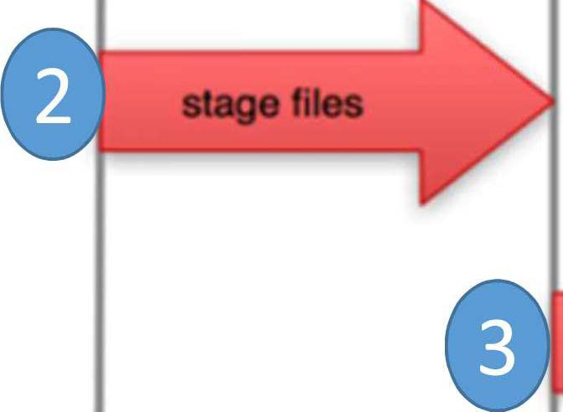

Local git operations
Local Operations
�
working directory
staging area
git directory (repository)
Unmodified/modified Files
Staged Files
Committed Files
8

Slide 9

Untracked, tracked, unstaged and staged changes
Untracked changes are not in Git.
This file exists locally, but isn't a part of the Git repository.
The file's change history will not be recorded and it will not be pushed to remote copies of repository.
Untracked files will show up when viewing your Git status.
A tracked file becomes untracked when running git rm --cached [file]. This will remove the file from Git while preserving local copy.
Tracked files are in git
Git tracks the file's change history and it will be pushed to remote copies.
These files will show up in your Git status report.
An untracked file becomes a tracked file when it is added using git add [file]
9

Slide 10

Untracked, unstaged and staged changes
Unstaged changes are in Git but not marked for commit.
Unstaged changes exist in working directory, but Git hasn't recorded them into its version history yet.
We usually want to stage them using git add <file> command
Staged changes are in Git and marked for commit.
Staged changes are a lot like unstaged changes, except that they've been marked to be committed.
Upon next commit, staged changes become part of your Git history.
To stage the changes: git add <file>
Have a last look at all staged changes before I commit
git diff --staged
10

Slide 11
Basic Git workflow
ile Status Lifecvcle
1. Modify files in the working directory.
ntracked
nmodified
2. Stage files, adding snapshots of them to staging area.
3.
Commit - takes the files in the staging area and stores to Git directory.
11

Slide 12


Terminology
Repository {repo): The database storing the files.
Server: The computer storing the repo.
Client: The computer connecting to the repo.
Working Copy: Our local directory of files, where we make changes.
master - the repository's main branch.
clone - copies an existing git repository, normally from some remote location to local environment.
commit - submitting files to the repository {the local one); in other VCS it is often referred to as "checkin"
12

Slide 13


Terminology
fetch or pull - is like "update" or "get latest" in other VCS.
push - is used to submit the code to a remote repository
.
-.........- ......,.
remote - these are "remote" locations of repository, normally on some central server.
SHA - every commit or node in the Git tree is identified by a unique SHA key.
head - is a reference to the node to which our working space of the repository currently points.
branch - a particular label on a given node.
13

Slide 14


Workstation Setup
To setup Git simply go to git-scm.com/downloads.
More detailed information can be found here as well:
http://git-scm.com/book/en/Getting-Started-lnstalling-Git
After everything is set, the first thing we have to do is to configure git with our name and email:
git config --global user.name "My Name"
git config --global user.email myemail@gmail.com

Slide 15


Lets get started: Create a new Git Repository
Before starting, lets create a new directory where the git repository will live and cd into it:
mkdir mygitrepo
cd mygitrepo
Now we're ready to initialize a brand new git repository.
git init
Initialized empty Git repository in c:/projects/mystuff/temprepos/mygitrepo/.git/
We can check for the current status of the git repository by using
git status
Create and commit a new file
$ touch hello.txt
$ echo Hello, world! > hello.txt

Slide 16

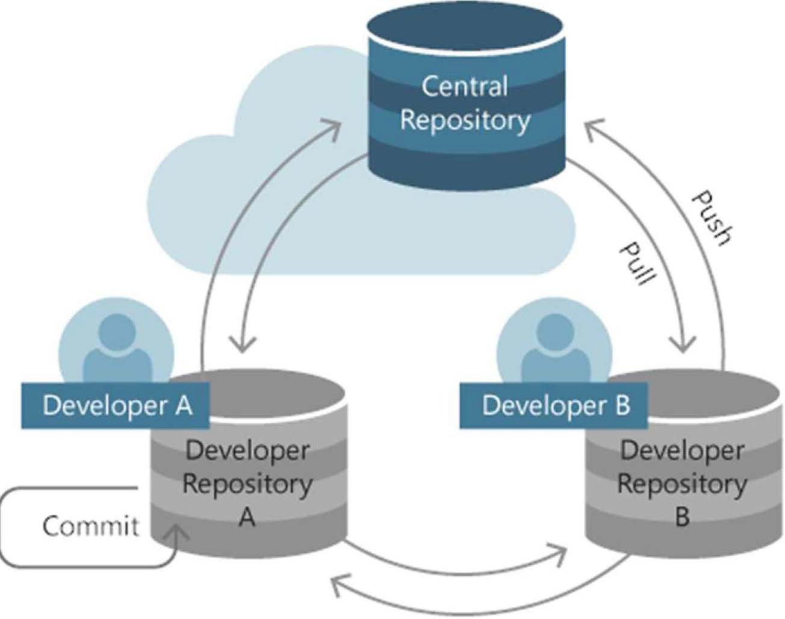
Lets get started: Create a new Git Repository
To "register" the file for committing we need to add it to git using
$ git add hello.txt
Checking for the status now indicates that the file is ready to be committed:
$ git status
# On branch master
• #
# Initial commit
• #
# Changes to be committed:
# (use "git rm --cached <file>..." to unstage)
• #
# new file: hallo.txt
• #

Slide 17

Lets get started: Create a new Git Repository
We can now commit it to the repository
$ git commit -m "Add my first file"
•
•
1 fiIe changed, 1 insertion( +) create mode 100644 hallo.txt

Slide 18
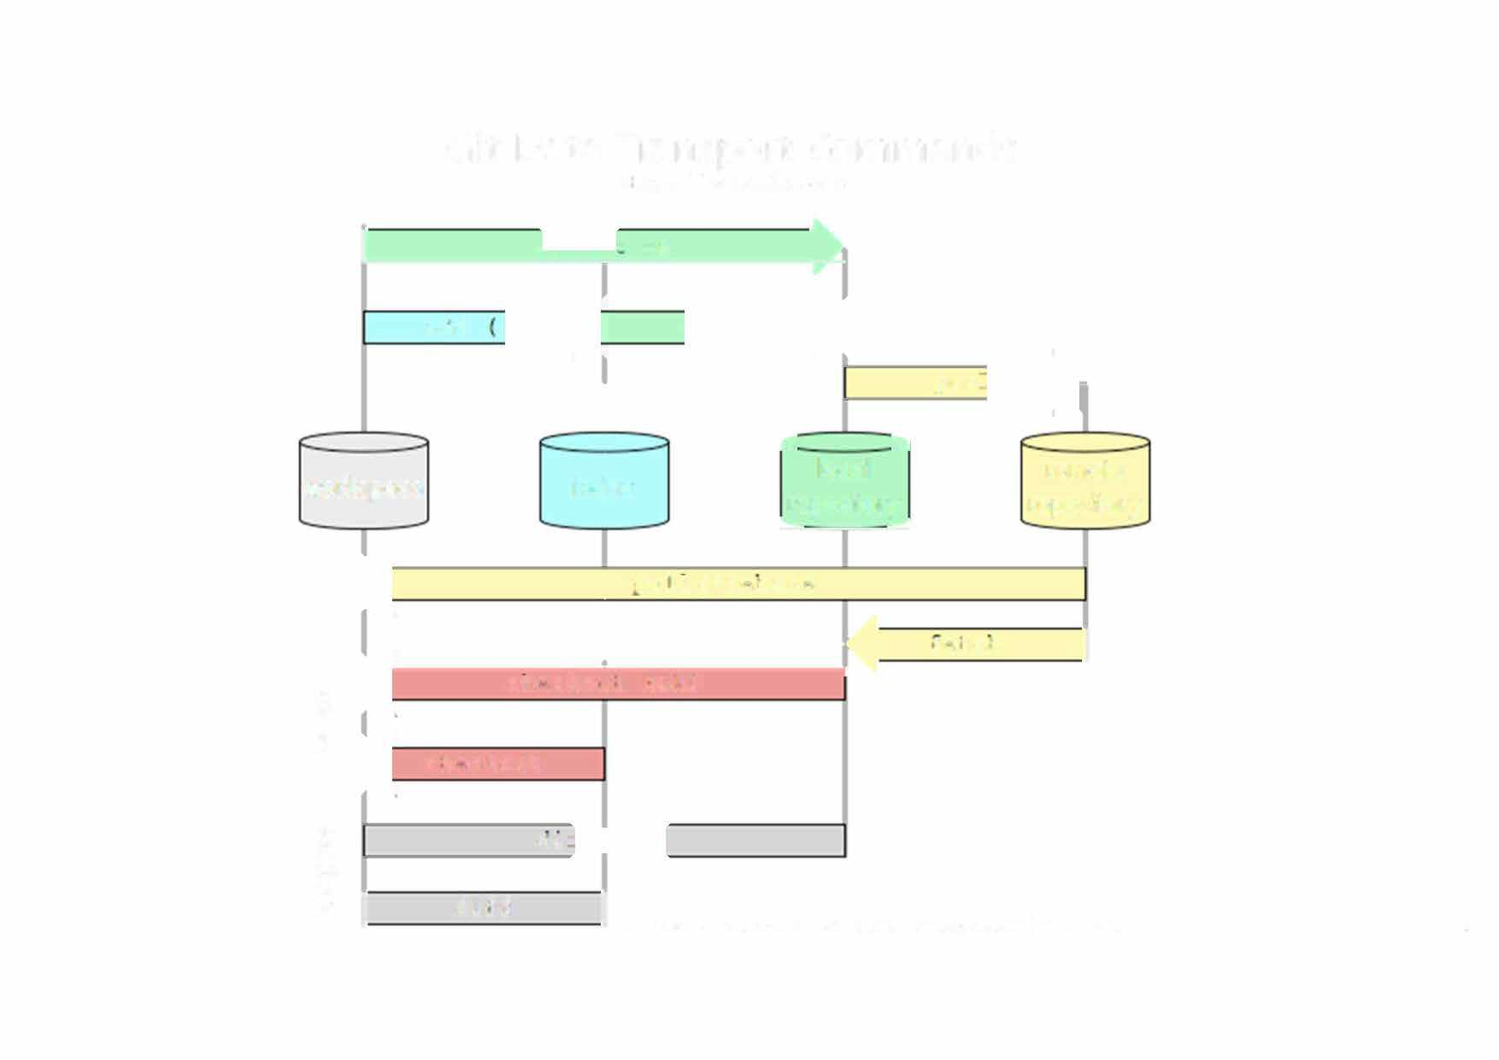

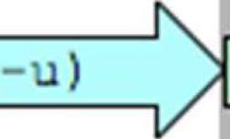
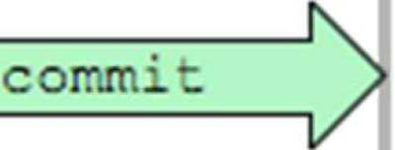
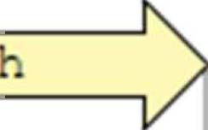




Git Data Transport Commands
h�tp://osteele.com
I
-a
)
add
pus
-­_..
C:
local
remote repository
workspace
index
repository
' - = = ,,,....-
L----------^{K} I
'Ou:.1 or rcoase
cnccko:.it HEAD checkout
!:CC:C!'I
�
�
Q)_{J.o}
s
Ql.
cu
8
I
di:f
I
18

Slide 19


Git commands
Command
git clone url [dir]
git add file git commit
git status git diff git help
[command]
git pull
git push
Description
Copy a Git repository so we can add to it
Adds file contents to the staging area Records a snapshot of the staging area
View the status of our files in the working directory and staging area Shows diff of what is staged and what is modified but unstaged
Get help info about a particular command
Fetch from a remote repo and try to merge into the current branch Push our new branches and data to a remote repository
19

Slide 20



CLONING EXISTING PROJECTS
• •
The syntax to pull down a local copy of an existing repo is:
git clone http://github.com/matthewmccullough/hellogitworld.git
The clone command performs several subtasks:
CLONES
ARE PEOPLE TWO
Sets up a remote (a Git repository address bookmark) named origin that points to the location http://github.com/matthewmccullough/hellogitworld.git
Asks this location for the contents of its entire repository.
Git copies those objects to the requester's local disk.
Switches to a branch named master
The local copy of this repo is now ready to have edits made, branches created, and commits issued - all while online or offline.
20

Slide 21


DIFF
A patch-style view of the difference between the currently edited and committed files
git diff
21

Slide 22

The full list of changes since the beginning of time:
LOG
git log
git log --since=yesterday
git log --since=2weeks
22

Slide 23

BLAME
To discover why, when and by whom a certain line was added
git blame <filename>
23

Slide 24

ABORTING
To abort current uncommitted changes and restore the working copy to the last committed state:
Discards all of currently uncommitted {unstaged or staged) changes:
git reset --hard
24

Slide 25


ADDING {STAGING)
When ready to put files into the next commit, they must first be staged with the add command.
git add .
git add * .java
25

Slide 26


COMMITTING
Once all desired files are staged, a commit command saves the pending additions to the local repository.
git commit
To supply the commit message directly at the command prompt:
git commit -m "<commit message>"
To view the statistics and facts about the last commit:
git show
26

Slide 27



THE REMOTE WORKFLOW
Working with remote repositories is one of the primary features of Git.
We can push or pull with colleagues.
REMOTES
A remote called origin is automatically created if we cloned a remote repository. The full address of that remote can be viewed with:
git remote v
To add a new remote name:
0
git remote add <remote name> <remote address>
27

Slide 28

PUSH/ PULL
To put changes from local repo in the remote repo
git push origin master
From remote repo to get most recent changes.
git pull
git pull <remote name>
git pull <remote name> <branch name>
k[PUSHj-+
+-�[PULL{
28

Slide 29

GitHub
GitHub.com is a site for online storage of Git repositories.
We can create a remote repo there and push code to it.
We can get free space for open source projects
Its not mandatory to use Github to use Git.
We can use Git locally for our own purposes.
We can also set up a server to share files.
We can share a repo with users.
29

Slide 30

30

